Slide 2
Introduction
In small groups:
Name and agency
Answer question – What has been the best part of your week so far?

Slide 3
How we got here
February 2023 Service Array Meeting – Harlan
Resource Deep Dive Meetings – March 2024
Finalize Priorities – May 2024
June 26, 2024 – start the work

Slide 4
Harrison, Monona, and Shelby County Hub Mission Statement
The mission of the HMS Hub is to create new resource paths of communication and reduce trauma for children and families of Harrison, Monona, and Shelby counties by expanding protective factors through increased service connections.

Slide 5
Housing Access
Assistance in securing needed housing – assistance in accessing publicly funded programs designed to provide suitable homes for those unable to find or pay for them, including low-rent public housing, rent subsidies, home ownership assistance and home maintenance programs for low-income families. This service includes assistance for homeless people through homeless shelters and support resources to reduce homelessness.

Slide 7
Housing Access Data
Work Hours/ week to rent 2-bed home at minimum wage (2)
H – 104.7 hours
M – 75.9 hours
S – 75.9 hours
Iowa – 80.6 hours
Home Ownership Rate (2)
H – 75%
M – 76%
S – 75%
Iowa – 71%

Slide 8
Basic Needs
Employment – assistance in securing and retaining employment. Also, services to assist develop the capabilities and skills to be employable.
Lack of income – employment provides living wage, benefits, including healthcare and adequate hours each week to meet the basic needs of the family.
Food insecurity – assistance in obtaining food. Education in obtaining nutritious food.

Slide 9
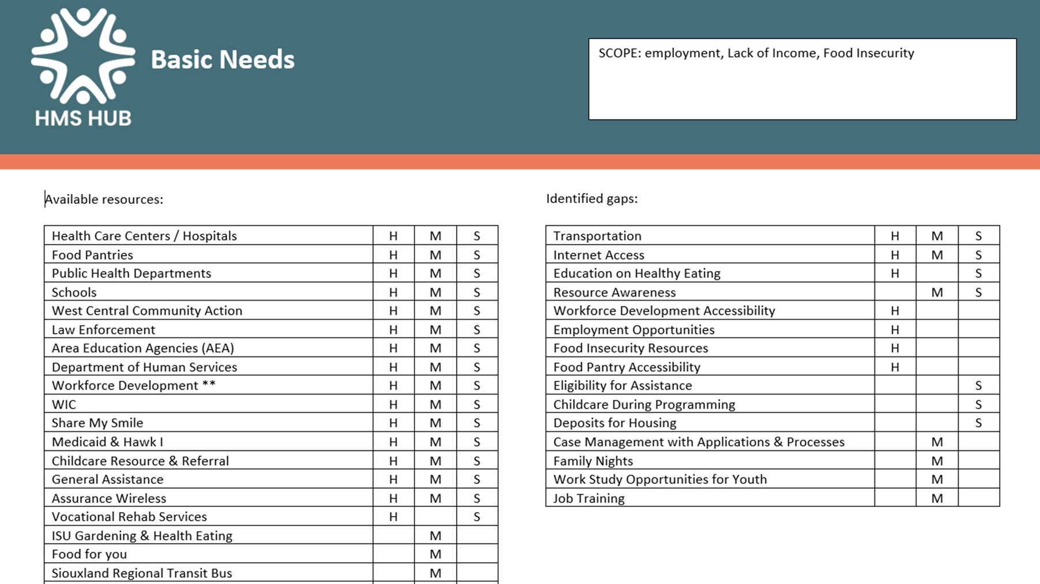

Slide 10
Meeting Basic Needs Data / Employment
Unemployment (2) Medicaid participants (1)
H – 3% unemployed – 30.6%
M – 3% pt/ temp working – 16.3%
S – 4 % Unemployed, not seeking work – 43.3%
Iowa – 4% Full time work – 19%
Wage needed to meet basic needs; single parent with 1 child under 6 (4)
H - $20.07 H - $15.48 State median wage - $19.19
M - $17.66 M - $14.81 State minimum wage - $7.25
S - $17.77 S - $16.74
Iowa - $21.16 Iowa - $16.11

Slide 11
Meeting Basic Needs Data / Lack of Income
Poverty Rate (2) Households Under 200% poverty (2)
H – 8% H – 25%
M – 13% M – 30%
S – 8% S – 27%
Iowa – 11% Iowa – 28%
In the past year unable to get any of the following when needed? (1)
Utilities – 23.7% Food – 33.4%
Transportation – 37% Eye care – 21.4%
Phone – 16.4% Dental care – 39.3%
Mental health – 18.1% Clothing – 21.2%
Medical Care – 16.6% Child care – 10.2%

Slide 12
Meeting Basic Needs Data / Food Insecurity
Reduced and free lunch eligibility (2) Accessing SNAP benefits (2)
H – 35% H – 10%
M – 46% M – 11%
S – 37% S – 12%
Iowa – 37% Iowa – 10%
Past 30 days, ever go hungry – youth (7)
 | H 6th | M | S | Iowa | H 8th | M | S | Iowa | H 11th | M | S | Iowa
Yes | 5% | 8% | 9% | 8% | 2% | 7% | 9% | 5% | 2% | 6% | 8% | 5%
No | 95% | 92% | 91% | 92% | 98% | 93% | 91% | 95% | 98% | 94% | 92% | 95%

Slide 13
Healthcare Access
Dental health – provision of general dental care services to children including those who have Medicaid or are not covered by insurance
Mental health assessment & treatment – an array of assessment and treatment supports for individuals. Including screenings for emotional and behavior disorders and resources for those with identified mental health and/or behavioral health concerns.
Physical health (including adolescent sexual health) – primary and basic health care services designed to treat, prevent, and detect physical and mental disorders and to enhance physical and psychosocial well-being. Adolescent sexual health is a continuum of programs and resources for HIV/STD and pregnancy prevention.

Slide 15
Healthcare Access Data / Dental Health
Dentist per population (3)
H – 2,200 : 1
M – 2,860 : 1
S – 1,680 : 1
US – 1, 380: 1
36% Medicaid participants in HMS region under age 6 received dental services – state 38.4% (ranked 31st among 38 ECI areas)
Past 12 months – had a dental problem would like to see a dentist, but you did not (1) – 12%
Past 12 months – went to ER for dental problem (1) – 1.3%

Slide 16
Healthcare Access Data / Mental Health
Poor mental health days/month (5) Stress levels (1)
H – 4.5 days very much or quite a bit – 16%
M – 4.5 days somewhat or a little bit – 41%
S – 4.4 days not at all – 44%
Iowa – 4.4 days
Have you been told you had depression or a depressive disorder - adult? (1)
Iowa – 18% yes 82% no
SW Region – 13% yes 87% no

Slide 17
Healthcare Access Data / Sexual Health
Teen births (3) Sexually transmitted infections (3)
H – 16 H – 227.8
M -14 M -232.2
S – 16 S – 218.3
Iowa – 16 Iowa – 478.5
US – 19 US – 481.3
Have you been tested for HIV – adult? (1)
Iowa – 26% yes 74% no SW Region – 24% yes 76% no

Slide 18
Healthcare Access Data / Physical Health
Adult Smokers (3) Adult obesity (3) Uninsured (3)
H -19% H – 40% H – 6%
M – 20% M – 36% M – 6%
S – 18% S – 39% S – 6%
Iowa – 17% Iowa – 37% Iowa – 6%
US – 16% US – 32% US – 10%
Health outcomes – how healthy a county is (length of life and quality of life) (3)
H - #68 of 99 counties M - #94 of 99 counties S - #33 of 99 counties
Health factors – things we can modify to improve length and quality of life (3)
H – lower 25-50% M – lowest 0-25% S – highest 75-100%

Slide 19
Prevention / Education
Substance use prevention – primary prevention programs which give priority to target population sub-groups that are at risk of developing a pattern of substance use.
Suicide prevention – a community-based approach for education and dialogue on recognizing and responding to the signs of suicide of people in your own life
Personal safety and development curriculum – services provided to children to meet their educational needs
Enhanced daily living skills to promote better health – community opportunities for individuals to develop healthy lifestyle through health education and/or participation in physical activity

Slide 22
Prevention Education Data / Suicide Prevention
Youth – past 12 mo. feel so sad or helpless that you stopped doing some activities? (7)
Youth – past 12 mo. thought about killing yourself? (7)
 | H 6th | M | S | Iowa | H 8th | M | S | Iowa | H 11th | M | S | Iowa
Yes | 30% | 35% | 18% | 27% | 30% | 34% | 17% | 29% | 38% | 39% | 40% | 36%
No | 70% | 65% | 82% | 73% | 70% | 66% | 83% | 71% | 63% | 61% | 60% | 64%
 | H 6th | M | S | Iowa | H 8th | M | S | Iowa | H 11th | M | S | Iowa
Yes | 18% | 20% | 18% | 17% | 18% | 21% | 4% | 21% | 34% | 24% | 27% | 24%
No | 82% | 80% | 82% | 83% | 82% | 79% | 96% | 79% | 66% | 76% | 76% | 76%

Slide 23
Prevention Education Data / Suicide Prevention
Poor mental health days/month (5) Stress levels (1)
H – 4.5 days very much or quite a bit – 16%
M – 4.5 days somewhat or a little bit – 41%
S – 4.4 days not at all – 44%
Iowa – 4.4 days
Have you been told you had depression or a depressive disorder - adult? (1)
Iowa – 18% yes 82% no SW Region – 13% yes 87% no

Slide 24
Prevention Education Data / Substance Use Prevention
Adult excessive drinking (3) Received SU treatment in 2023 (5)
H – 25% H - 38
M – 25% M -29
S – 25% S -49
Iowa – 25% Iowa -17,477
SU involved mortalities in 2020 (1) ER & hospital for SU reasons (1)
H - 11 H – 165 ER
M - 12 M – 109 ER & 8 hospital = 117
S –suppressed between 1-5 S – 168 ER & 11 hospital = 179
Iowa – 661 (44% increase)

Slide 25
Prevention Education Data / Substance Use Prevention
Alcohol use age 12-17 (9) Binge Alcohol use age 18-25 (9)
Region – 10% Region – 78%
Iowa – 10% Iowa – 42%
US – 9% US – 35%
Marijuana use age 12-17 (9) Marijuana use age 18-25 (9)
Region – 14% Region - 32%
Iowa – 12% Iowa – 30%
US – 16% US – 35%

Slide 26
Childcare & Early Childhood Education
Early Childhood Education – programs to provide preschool children of disadvantaged families compensatory education to offset effects of social deprivation
Early Intervention – home visitation programs for early intervention to mobilize resources in a child and family centered, strength-based process with planning.
Educational services for parents/caregivers – educational classes to provide support and resources to help parents meet their children’s educational and emotional needs.

Slide 28
Childcare & Early Childhood Education
 | Harrison | Shelby | Monona
Children 0-6 | 980 | 540 | 740
Total spots | 493 | 366 | 432
Family w all parents working w children under 6 | 88% | 67% | 72%
Median income | $81,698 | $71,688 | $87,147
Income on childcare | 11% | 10% | 9%
Annual cost of infant care (4)
H - $8,466
M - $7,488
S - $8,125
Iowa - $11,129

Slide 29
Childcare & Early Childhood Education
¾ y.o. in preschool (4)
H – 59%
M – 68%
S – 38%
Iowa – 46%
School readiness – reach kindergarten readiness benchmark (6)
2021-2022 – 68%
2022-2023 – 72%

Slide 31
Questions

Slide 32
We need your help
What will the HMS Hub priorities be?
Vote for top 2 choices –
Save the Date – June 26th 9am – 2pm Rand Community Center – Missouri Valley

Slide 33
Data Resources
Iowa Department of Health and Human Services Agency Dashboard Imitative
Agency Dashboards | Health & Human Services (iowa.gov)
2. Casey Family Programs Community Opportunity Map
The Community Opportunity Map - Casey Family Programs
3. Iowa County Health Rankings & Roadmaps
Iowa | County Health Rankings & Roadmaps
4. Common Good Iowa Data Snapshot
Data | Common Good Iowa
5. Iowa Health and Human Services System Snapshot
HHS System County Snapshots | Health & Human Services (iowa.gov)
6. Kindergarten Assessment by ECI Area
7. Iowa Youth Survey 2021
Report Template (iowa.gov)
8. Behavioral Risk Factor Surveillance System (BRFSS)
Behavioral Risk Factor Surveillance System (BRFSS) | Health & Human Services (iowa.gov)
9. Behavioral Health Barometer Iowa, V 6
Iowa-BH-Barometer_Volume6.pdf

Slide 34
Evaluation

Slide 35
Thank you
Tiffani Pinkerton
Collaborative Director
6 West 7th St
Woodbine, IA 51579
tpinkerton@thrivingfamiliesalliance.org
712-482-1280

